Slide 1
Machine Learning-based Nutrient Application’s Timeline Recommendation for Smart Agriculture: A Large-Scale Data Mining Approach
A Short story presented by
Suresh ravuri
Sjsu id - 017451824

Slide 2
Introduction to Digital Agriculture
The Emergence of Digital Agriculture: Digital agriculture is revolutionizing farming by introducing autonomous procedures that are highly customizable. Central to this transformation is data, primarily gathered from various sources like in-field sensors, remote sensors, and farm machinery. This data-driven approach enables precise monitoring and decision-making tailored to the specific requirements of each arable field.
Fertilizer Application and Types: A critical aspect of modern agriculture is the efficient application of fertilizers, which are broadly categorized into organic and chemical types. Each type has its distinct application methods and timelines, crucial for enhancing crop yield and soil fertility. The decision-support systems in digital agriculture play a pivotal role in predicting the optimal application of these fertilizers.
Economic and Environmental Challenges: The field faces significant challenges, such as the soaring costs of nitrogen fertilizers due to fluctuations in natural gas prices and the consequent impact on global fertilizer use efficiency. These economic factors, coupled with environmental concerns, underscore the need for optimized fertilizer application strategies.
Leveraging Advanced Algorithms for Optimized Decision Making: To tackle the complexity of fertilizer optimization, advanced algorithms like decision trees and Random Forest are employed. These methods are particularly adept at handling the dynamic nature of environmental factors and making informed decisions based on a multitude of variables. The Random Forest algorithm, with its ability to amalgamate insights from multiple decision trees through a voting system, stands out as a robust solution for managing the unpredictability and variability in agricultural data.

Slide 3
Machine Learning Models for Precision Agriculture
Machine learning (ML) and deep learning (DL) models are transforming the agricultural sector by providing advanced solutions for crop yield prediction and fertilizer optimization. Traditional regression models, once reliable for estimating crop yield, are now challenged by their computational intensity and limited scalability. In contrast, ML models, including Random Forest (RF) and Multivariate Regression Trees (MRTs), have proven effective in handling complex, noisy datasets and nonlinear relationships, crucial for accurate agricultural predictions.
Recent advancements in RF have enhanced its ability to handle decision tree predictions and ensemble techniques, making it more resilient to noise. Moreover, MRTs have gained attention for their ability to predict multiple continuous target variables, recognizing dependencies among variables effectively.
Addressing large-scale agricultural data poses challenges like significant missing values, noise, and outliers. To tackle these, we developed efficient algorithms for data preprocessing, dimensionality reduction, and noise smoothing. By subdividing datasets and constructing nutrient application timelines, we aim to mimic farmer practices, incorporating factors like weather conditions and time intervals between fertilizer applications. This approach enables us to accurately predict nutrient application timelines, crucial for optimized agricultural practices.

Slide 4
Data Construction
We developed a timeline construction method that incorporates the subdivided data, which focused primarily on nitrogen but could be adapted for other nutrients. The process consisted of the following steps:
Fig 1: Data Construction - Efficiently predicting nutrient application timeline.

Slide 5
SYSTEM ARCHITECTURE
Fig 2: Simplified Model - A brief illustration of a two-stage model predicting nitrogen timelines, applicable to other nutrients.

Slide 6
The system architecture, illustrated in Fig. 3, comprises three parts: data management, Random Forest regression, and multioutput regression using a multivariate approach. Raw data, including weather, fertilizer, and nutrient application timelines, is cleaned, and processed using techniques like nutrient dictionaries and feature extraction. This data is prepared for machine learning through encoding and conversion of categorical attributes, such as soil type. Fertilizer applications are separated, and data pipelines are created for each. Data is then divided for univariate and multivariate approaches, enabling prediction of multiple outputs. The two models are pipelined, with the output of the first model serving as input for the second. Further component details follow in subsequent sections.
Fig. 3: System Architecture Overview - Illustrating the three-part division of the system, including data management, Random Forest regression model, and multi-output Random Forest regression using a multivariate approach.

Slide 7
SYSTEMATIC MODEL
We developed a two-stage simplified systematic model (Fig 2) specifically for predicting nitrogen applications.
Stage 1 - Determining Application Count: The initial stage of the model processes inputs like the application predictors for Nitrogen and other nutrients (P, K, S, Mg, B, Mn, Ca) to predict the number of nitrogen applications needed. For instance, it might suggest three nitrogen applications based on the input data.
Stage 2 - Quantity and Timing Prediction: Following the first stage, the model focuses on predicting the quantity of nitrogen and the specific days for each application, relative to the seeding date. This stage uses weather predictors and nutrient-specific data for each application, allowing for precise scheduling, such as predicting applications at 115, 185, and 220 days from seeding.
Efficient Nitrogen Management: This two-tier approach enables accurate predictions of both the number and timing of nitrogen applications, significantly improving nitrogen management in agriculture.
From Simplified to Complex Model Applications: Initially, the research utilized a simplified model to understand the basic methodology for nitrogen application prediction. Progressing to more complex scenarios, the model was adapted to include all nutrients, demonstrating its effectiveness in predicting application timelines for a comprehensive nutrient management strategy.
Advanced Model for Comprehensive Predictions: The final, sophisticated model extends its capabilities to all essential nutrients, offering a detailed and accurate prediction of application timelines. This model's outcomes are integral to our research, showcasing its ability to handle complex agricultural scenarios and optimize nutrient management.

Slide 8
Fig. 4: Advanced Two-Stage Model - Illustrating the architecture for predicting application timelines, quantities, and days for all nutrients.
Based on the given data, the maximum nutrient application count (app max count) has been determined in TABLE 3 for both the available data and the predicted model on the test data The model’s results generated a timeline for each nutrient based on the required number of applications, as elaborated in the following Evaluation section.

Slide 9
EVALUATION
We evaluated the performance of our models using the accuracy of the train and test sets, along with cross-validation to ensure that the models were not overfitting and could generalize well to new data. To further assess the robustness of our models, we calculated the standard deviation of the cross validation results in TABLE 1 and TABLE 2 respectively. A higher standard deviation indicates that the model’s performance is weaker, and the data may not fit well. Conversely, a lower score indicates a more robust model. We trained each nutrient separately using a similar model configuration, albeit with different datasets and features.
Nutrients Application Count:
In the first stage of our model, we predict the number of applications for each nutrient during the cropping season. This stage, less data-intensive than the second, showed high training accuracy (0.97% to 0.99%) and varied test accuracy (0.74% to 0.94%). Notably, Boron, Manganese, and Calcium had fewer applications, affecting their accuracy scores. Manganese, in particular, showed a testing accuracy of 0% but 0.55% in 10-fold cross-validation. The standard deviation for the first five nutrients was lower compared to the last three, suggesting room for improvement with more data.

Slide 10
TABLE 1: ACCURACY FOR THE FIRST MODEL NUTRIENTS APPLICATION COUNT PREDICTION.

Slide 11
Nutrients Application Timeline:
The second stage of model (Fig. 4) predicts the nutrient application timeline, determining the timing of crop fertilization for each nutrient during the cropping season. This more complex stage showed varied results, with training accuracy ranging from 0.935 to 0.975 and test accuracy from 0.712 to 0.995 for nutrients like nitrogen, magnesium, and boron. However, the model did not predict any applications for manganese and showed lower accuracy for phosphorus and calcium. The variability in cross-validation results, with standard deviation scores between 0.0134 and 0.797, indicated a more challenging task compared to the first stage. Despite these challenges, the model offers valuable insights for optimizing fertilization and enhancing crop yields.
TABLE 2: ACCURACY FOR THE SECOND MODEL NUTRIENTS APPLICATION TIMELINE PREDICTION

Slide 12
Crop Nutrient Application Schedule:
The results present a learning-based crop nutrient application schedule specifically for winter wheat crops, developed using best practices. The model processes input data to create a nutrient application timeline tailored to crop needs. The first stage predicts nutrient applications, which are then refined by the second stage using a specific subset of data, optimizing nutrient applications according to a large dataset. Table 3 compares the initial predictions from the first stage with the refined and actual applications from the second stage, forming the basis for subsequent nutrient timelines.
TABLE 3: COMPARISON OF NUTRIENT APPLICATION PREDICTIONS BETWEEN THE FIRST MODEL AND THE REFINED

Slide 13
Timeline-Driven Outcomes:
In our timeline-driven outcomes section, we display graphical representations of nutrient application schedules for Nitrogen, Potassium, Sulphur, and Magnesium, using distinct visual indicators and colors for clarity. Notably, the model did not suggest applications for Phosphorus, Boron, Manganese, and Calcium, while varying recommendations were made for other nutrients. The timelines illustrate nutrient quantities and predicted yields, along with application timings throughout the crop's growth period. Key indicators include green round pointers for nitrogen quantity (kg/ha), red diamonds for nitrogen application days, sky-blue triangles for total nitrogen used per season, and blue triangles and bars for the total expected yield (tons/ha) post-application.
Nitrogen Application Timeline:
Shows three recommended applications at approximately 41, 58, and 78 Kg/ha of farmland, with the first application at around 115 days after seeding, the second at around 185 days, and the third at around 220 days. The predicted total yield and total nitrogen required are 9.9 tons/ha and 177 Kg/ha, respectively.

Slide 14
Potassium Application Timeline:
Suggests only one application of approximately 24 Kg/ha, with a total recommended application of 25 Kg/ha. The predicted crop yield is similar to that for nitrogen, at 9.8 tons/ha.
Sulphur Application Timeline:
Recommends one application at around 82 Kg/ha, to be applied at 117 days from the seeding date, with a predicted yield of 9.8 tons/ha. However, the total application predicted is 142 Kg/ha, which is higher than the single application prediction, warranting further investigation in future research.
Magnesium Application Timeline:
Indicates a single application of approximately 15 Kg/ha, with a total predicted application of 20.5 Kg/ha. The predicted yield is consistent across all nutrient applications.

Slide 15
Fig 5: Application Timelines -Nitrogen, Potassium, Sulphur, and Magnesium, showcasing recommended nutrient quantities and application days.

Slide 16
CONCLUSION
In conclusion, our study introduces a new two-step method using machine learning to handle big, varied datasets in farming. This method accurately forecasts when and how much fertilizer to use for different crops throughout their growing season. Our main achievements are creating an effective way to manage large datasets and predict fertilizer needs, which is especially useful for bigger farming operations. Looking ahead, we plan to make our model even more accurate while keeping it simple. Our approach stands out for its innovative way of using data to improve farming practices, making it a valuable addition to agricultural technology.

Slide 17
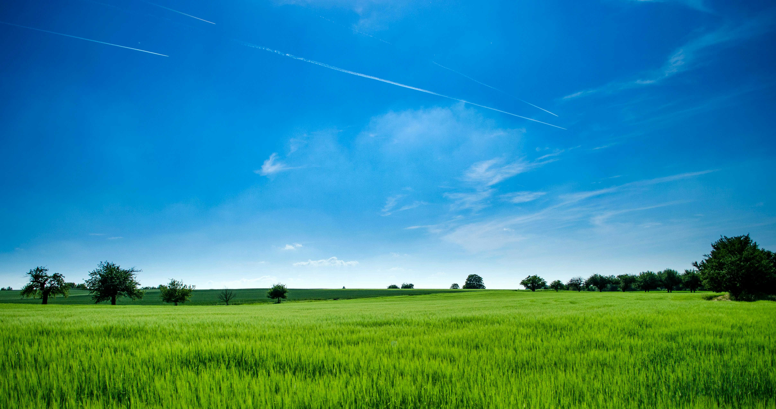
THANKS NAMASTE

